Slide 1
World History Group Discussion
Mr. Walker
Copyright© 2013 EducAide Software Inc. All rights reserved.

Slide 2
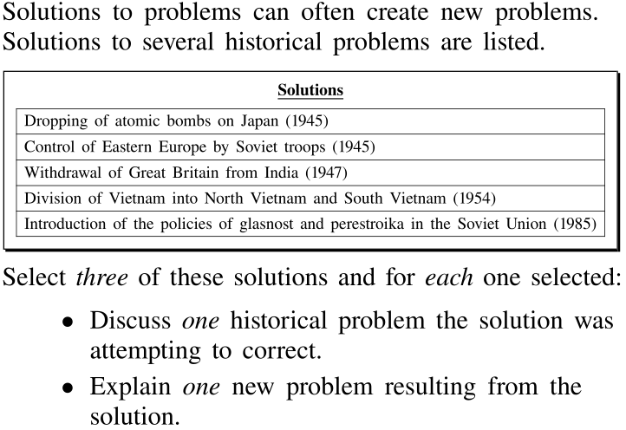
1
Copyright© 2013 EducAide Software Inc. All rights reserved.

Slide 3
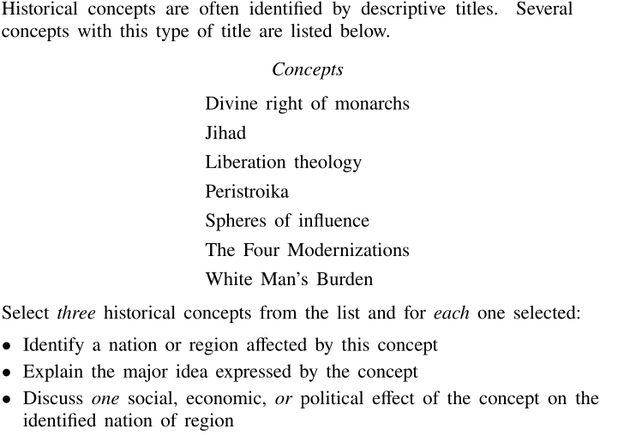
2
Copyright© 2013 EducAide Software Inc. All rights reserved.

Slide 4
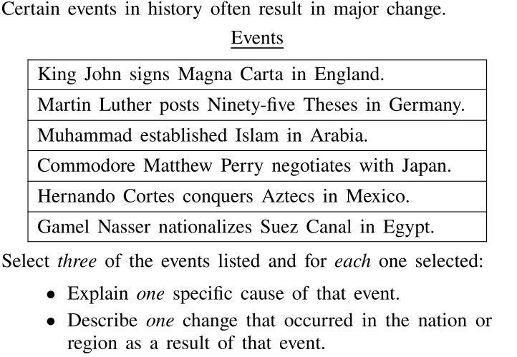
3
Copyright© 2013 EducAide Software Inc. All rights reserved.

Slide 5
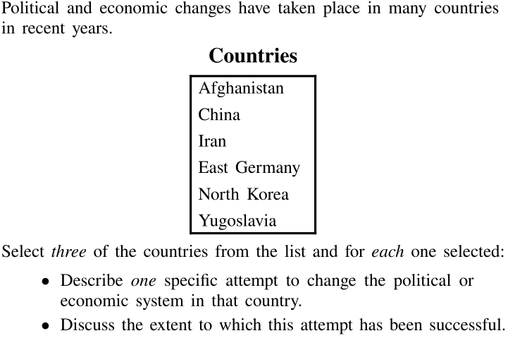
4
Copyright© 2013 EducAide Software Inc. All rights reserved.

Slide 6
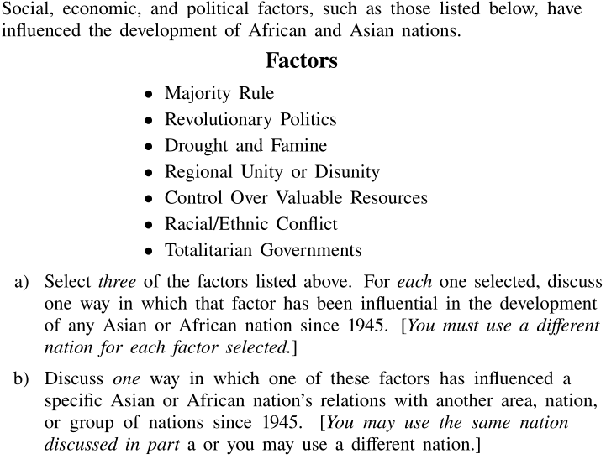
5
Copyright© 2013 EducAide Software Inc. All rights reserved.

