Slide 1
Number and Quantity Quick Check
Ms Nelson
Copyright© 2013 EducAide Software Inc. All rights reserved.

Slide 2
1
Copyright© 2013 EducAide Software Inc. All rights reserved.

Slide 3
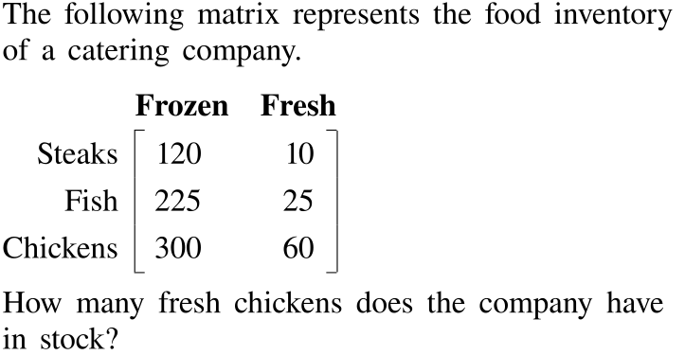
2
Copyright© 2013 EducAide Software Inc. All rights reserved.

Slide 4
3
Copyright© 2013 EducAide Software Inc. All rights reserved.

Slide 5
4
Copyright© 2013 EducAide Software Inc. All rights reserved.

Slide 6
5
Copyright© 2013 EducAide Software Inc. All rights reserved.

Slide 7
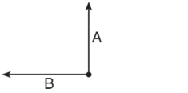
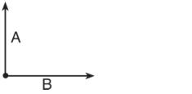
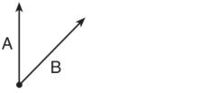
6
Copyright© 2013 EducAide Software Inc. All rights reserved.

Slide 8
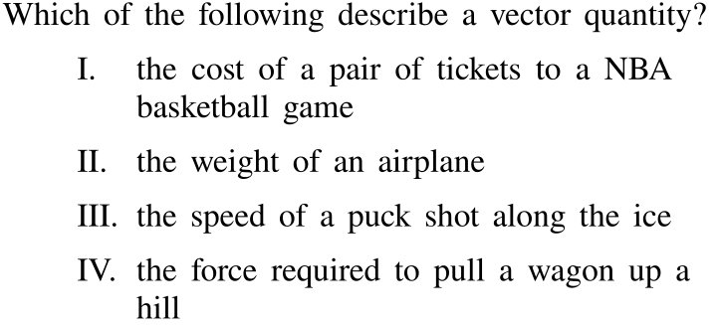
7
Copyright© 2013 EducAide Software Inc. All rights reserved.

Slide 9
8
Copyright© 2013 EducAide Software Inc. All rights reserved.

Slide 10
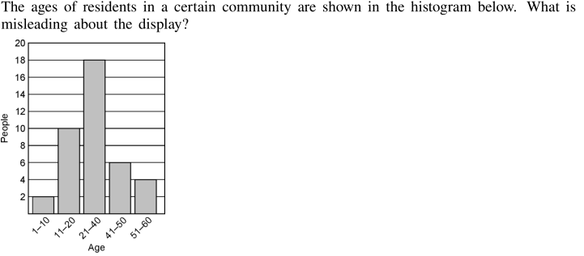
9
Copyright© 2013 EducAide Software Inc. All rights reserved.

