Slide 1


Grade 3 Math Review
Ms Nelson
Copyright© 2013 EducAide Software Inc. All rights reserved.

Slide 2









1
Copyright© 2013 EducAide Software Inc. All rights reserved.

Slide 3
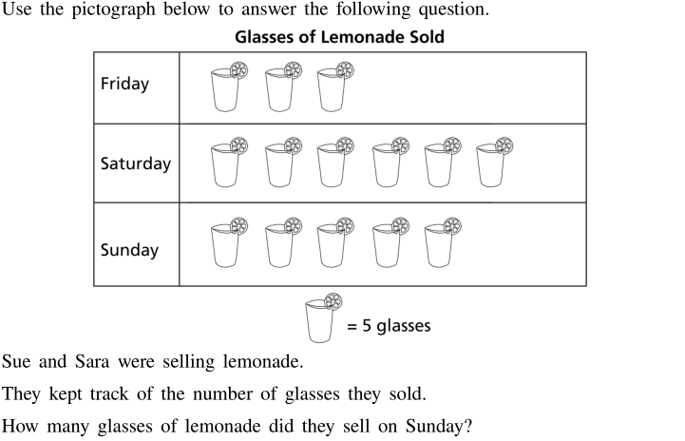
2
Copyright© 2013 EducAide Software Inc. All rights reserved.

Slide 4
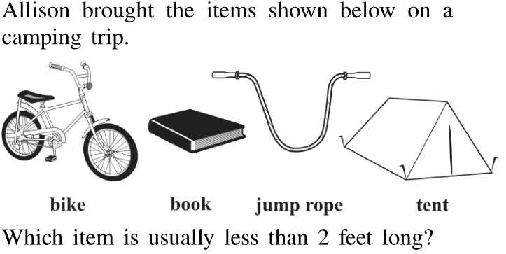

3
Copyright© 2013 EducAide Software Inc. All rights reserved.

Slide 5
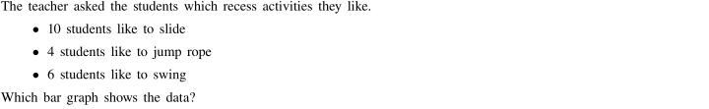
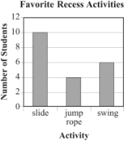
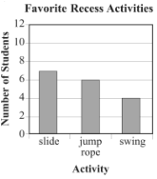
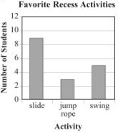
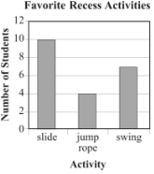
4
Copyright© 2013 EducAide Software Inc. All rights reserved.

Slide 6
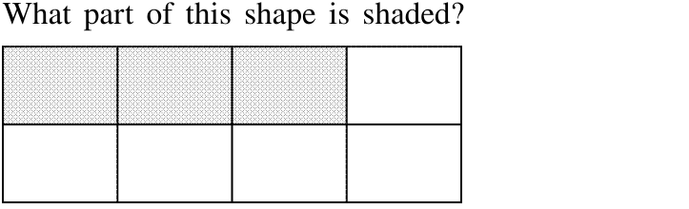




5
Copyright© 2013 EducAide Software Inc. All rights reserved.

Slide 7
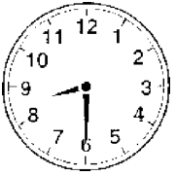

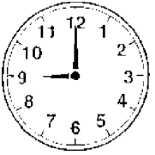
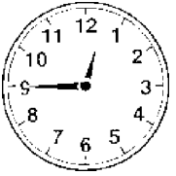
6
Copyright© 2013 EducAide Software Inc. All rights reserved.

Slide 8
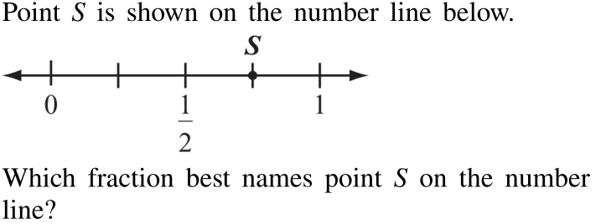




7
Copyright© 2013 EducAide Software Inc. All rights reserved.

Slide 9
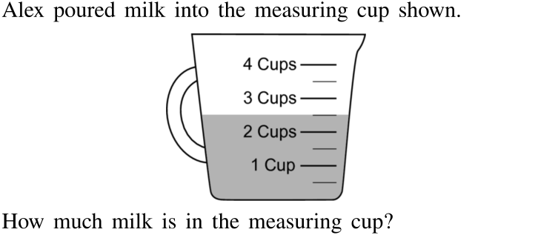




8
Copyright© 2013 EducAide Software Inc. All rights reserved.

