Slide 1
Cell Surprise Quiz
Mr Noodle
Copyright© 2013 EducAide Software Inc. All rights reserved.

Slide 2
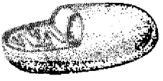
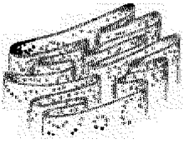
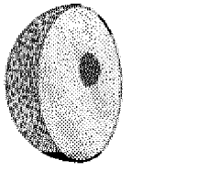
1
Copyright© 2013 EducAide Software Inc. All rights reserved.

Slide 3
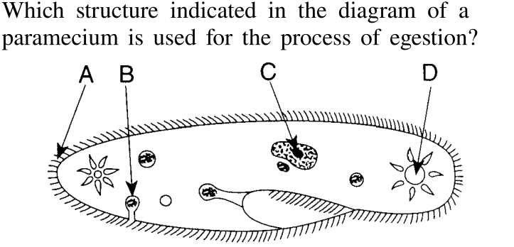
2
Copyright© 2013 EducAide Software Inc. All rights reserved.

Slide 4
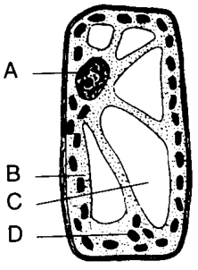
3
Copyright© 2013 EducAide Software Inc. All rights reserved.

Slide 5
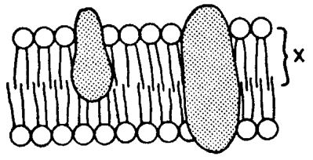
4
Copyright© 2013 EducAide Software Inc. All rights reserved.

Slide 6
5
Copyright© 2013 EducAide Software Inc. All rights reserved.

Slide 7
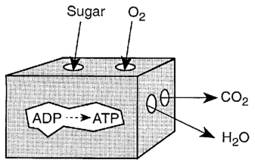
6
Copyright© 2013 EducAide Software Inc. All rights reserved.

Slide 8
7
Copyright© 2013 EducAide Software Inc. All rights reserved.

